Slide 1

Algebraic manipulation
Implementation of IFFT using FFT for finding polynomial

Slide 2
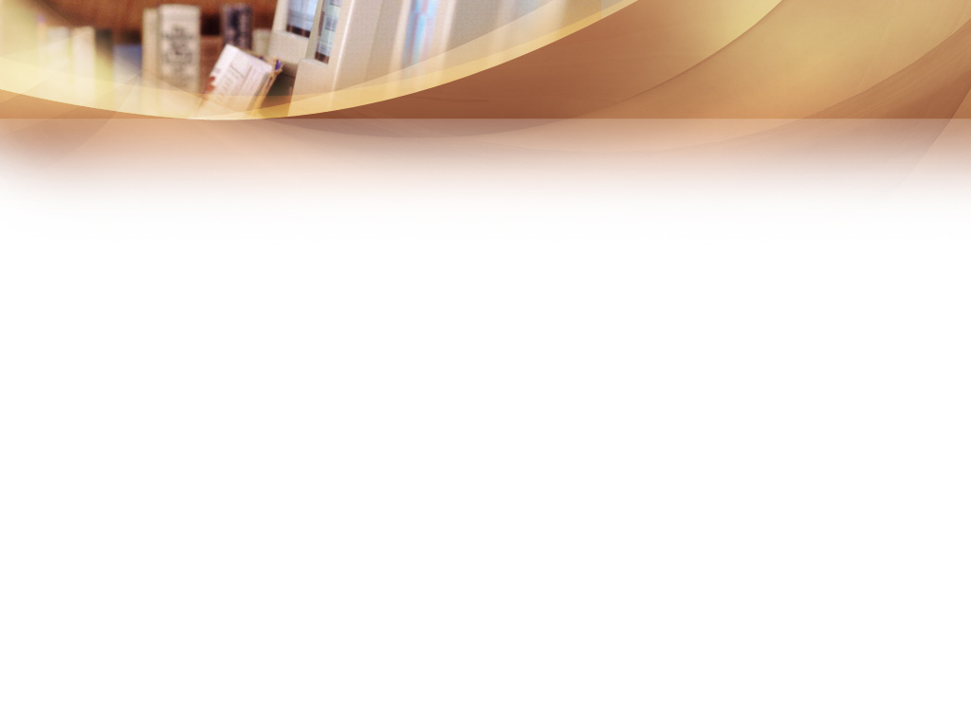
Presented by
Tanvir Ahammad (ID# 108407
Md. Sajib Al Mamun (ID#108404)
Instructed by
Tanay Kumar Saha
Lecturer, Dept. of CSE, JnU.

Slide 3

Contents
Introduction
History
Application
Problem concept
Algorithm
Complexity analysis
Implementation
References

Slide 4

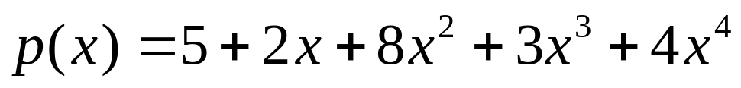
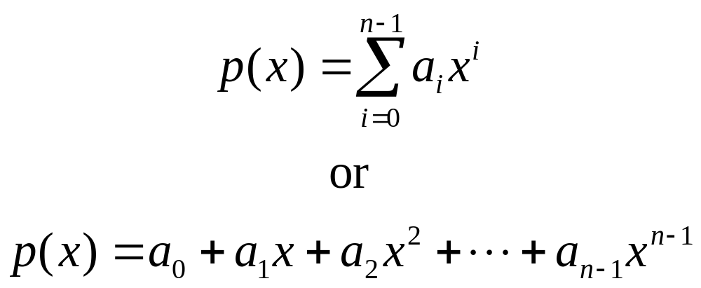

Introduction
Polynomial:
In general,

Slide 5
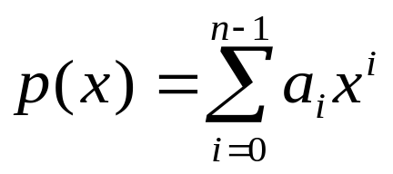


Introduction(cont.)
Representing polynomial:
Coefficient representation,
of a polynomial
Of degree -bound 'n' is vector of a=(a₀,a₁,a₂,…,a_{n-1})
Point-value representation,
of a polynomial p(x) of degree-bound 'n' is a set of 'n'
pair point-values {(x0,y0),(x1,y1) ,....,(xn-1,yn-1)

Slide 6
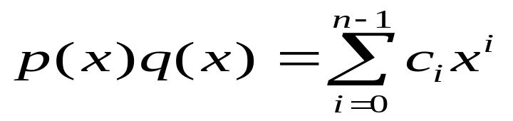
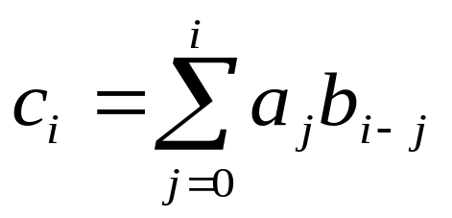

Introduction(cont.)
Polynomial evaluation:
Straightforward evaluation.
Horner's method.
Using brute force (for multiplication)

Slide 7
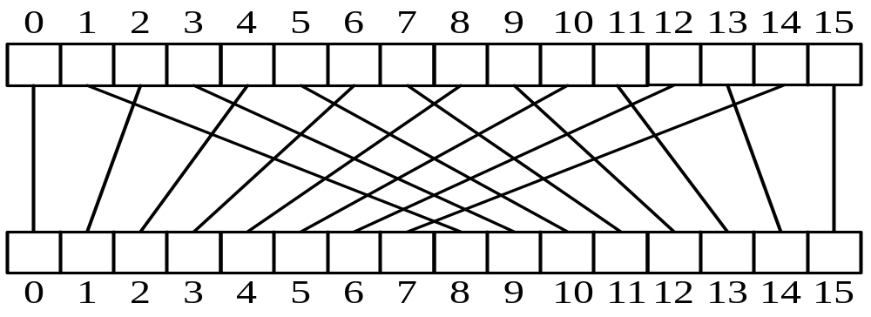

Introduction(cont.)
Using FFT and IFFT.

Slide 8
Introduction(cont.)
FFT and IFFT:
The most common tools used to perform Fourier analysis and synthesis .
Optimized (very fast) computer-based algorithms that perform a generalized mathematical process called the discrete Fourier transform (DFT).
Really important to a lot of disciplines when engineers figured out how to take samples quickly enough to generate enough data to re-create sound and other analog phenomena digitally.

Slide 9

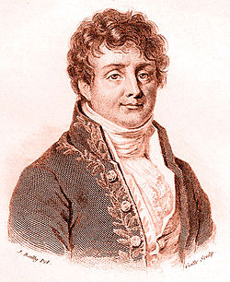
History
Born : 21 March 1768 Auxerre, Burgundy,
Kingdom of France
(now in Yonne, France)
Died : 16 May 1830 (aged 62)
Paris, Kingdom of France
Residence : France
Nationality : French
Fields :Mathematician,
physicist, and historian
Known for : Fourier series ,Fourier
transform ,Fourier's law of conduction
Jean Baptiste Joseph Fourier
(1768-1830)
Source: https://en.wikipedia.org/wiki/Joseph_Fourier

Slide 10
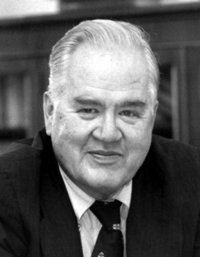
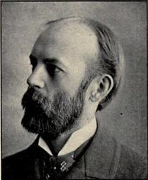

History(cont.)
Gauss (1805, 1866). Analyzed periodic motion of asteroid Ceres.
Runge-König (1924). Laid theoretical groundwork.
Danielson-Lanczos (1942). Efficient algorithm, x-ray crystallography.
Cooley-Tukey (1965). Monitoring nuclear tests in Soviet Union and tracking submarines. Rediscovered and popularized FFT and IFFT.
Tukey Cooley

Slide 11
History(cont.)
“ The FFT and IFFT is one of the truly great computational
developments of [the 20th] century. It has changed the
face of science and engineering so much that it is not an
exaggeration to say that life as we know it would be very
different without the FFT. ” — Charles van Loan

Slide 12

Application
Optics, acoustics, quantum physics, telecommunications, radar,control systems, signal processing, speech recognition, data compression, image processing, eismology, mass spectrometry…
Digital media. [DVD, JPEG, MP3, H.264]
Medical diagnostics. [MRI, CT, PET scans, ultrasound]
Numerical solutions to Poisson's equation.
Shor's quantum factoring algorithm.

Slide 13
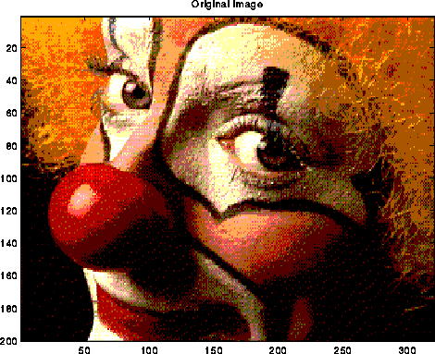
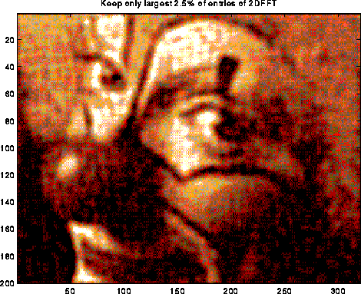
Application(cont.)
Image = 200x320 matrix of values
Compress by keeping largest 2.5% of FFT components
Similar idea used by jpeg
FFT and IFFT on image processing.

Slide 14


Problem concept
Why IFFT and FFT?
Ans:
a. Straightforward implementation: Θ(n²)
b. Using Horner's method: O(n)
c. Using brute force :O(n²):
d. Using Lagrange's formula:O(n²):
e. Using Gaussian elimination:O(n^3)
f.Using DFT :O(n²)
So, using DFT is not a best way in practice. BUT!!
Fast Fourier Transform and its inverse:
Produces exactly the same result as the DFT and IDFT and time
complexity O(n log(n))..

Slide 15

Problem concept(cont.)
The FFT and IFFT?
We convert from coeff. to PV using FFT by evaluating at the n complex n^{th} roots of unity.
We convert from PV to Coeff. using IFFT by evaluating at the n complex n^{th} roots of unity.
(a0,a1,....an-1) (w0,y0),...(wn-1,yn-1)
Note:We compute DFT ,IDFT using FFT and IFFT.

Slide 16
Problem concept(cont.)
Complex roots of unity.
Denote as ω_{n}⁰, ω_{n}¹, …, ω_{n}^{n-1 , where}
ω_{n}^{k}=e^{2πiK/n}.
We have (ω_{n}^{k} )^{n} = 1 for each k.
Proof:
(ω_{n}^{k} )^{n} = e^{2πik}
= cos(2πk) + i sin(2πk), follows from e^{iu} = cos(u) + i sin(u).
= 1

Slide 17
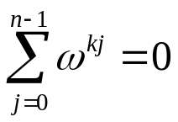
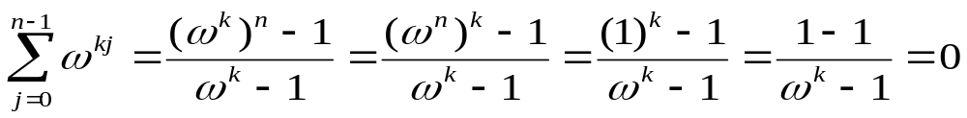

Problem concept(cont.)
Properties of 'Omega':
Inverse Property: If ω is a primitive root of unity, then ω ⁻¹=ω^{n-1}
Proof: ωω^{n-1}=ω^{n}=1
Cancellation Property: For non-zero -n<k<n,
Proof:
Reduction Property: If w is a primitive (2n)-th root of unity, then ω² is a primitive nth root of unity
Proof: If 1,ω,ω²,…,ω^{2n-1} are all distinct, so are 1,ω²,(ω²)²,…,(ω²)^{n-1}
Reflective Property: If n is even, then ω^{n/2} = -1.
: By the cancellation property, for k=n/2:

Slide 18
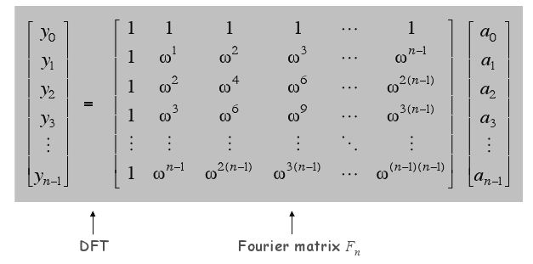
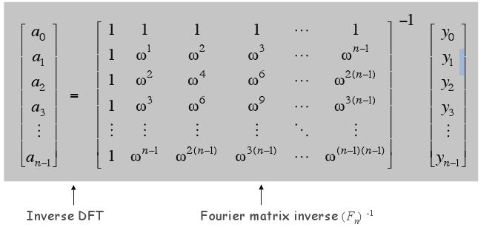

Problem concept(cont.)
How to compute FFT and IFFT?
*Using the matrix form:

Slide 19
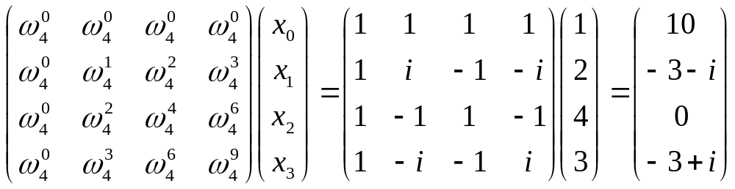
Problem concept(cont.)
Example:Compute DFT of vector (1, 2, 4, 3) using Matrix
ω_{n}^{k} = e2πik/n=cos(2πk/N) + i sin(2πk/N)
Note: FFT computes DFT and IFFT computes IDFT.

Slide 20
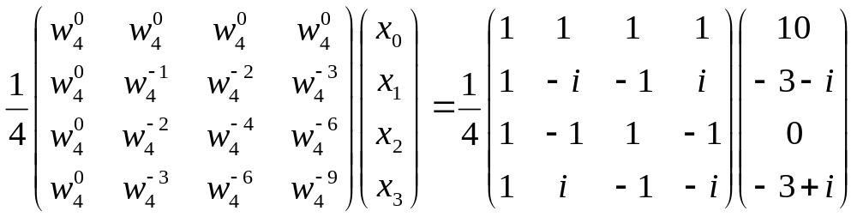
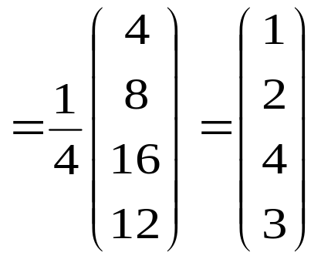
Problem concept(cont.)
Compute IDFT of previous example.
ω_{n}^{k} = e-2πik/n=cos(2πk/N) - i sin(2πk/N)

Slide 21
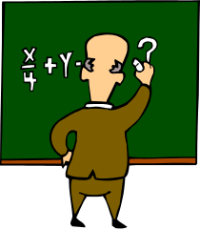

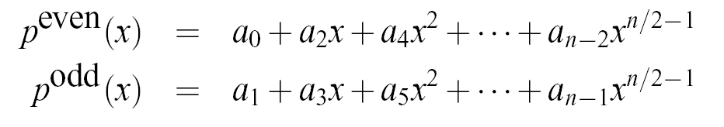

Algorithm
Inverse Fast Fourier Transform(IFFT)
-is an efficient algorithm for computing the IDFT
- is based on the divide-and-conquer paradigm
( just like FFT)
If n is even, we can divide a polynomial
and we can write

Slide 22
Algorithm a (cont.)
FFT algorithm
IFFT algorithm
Recursive-FFT(a)
1 n := length[a];
2 if n =1 then
3 return a
4 ω_{n} := e^{2πi/n};
5 ω := 1;
6 a^{[0]} := (a₀, a₂, …, a_{n-2});
7 a^{[1]} := (a₁, a₃, …, a_{n-1});
8 y^{[0]} := Recursive-FFT(a^{[0]});
9 y^{[1]} := Recursive-FFT(a^{[1]});
10 for k := 0 to n/2 – 1 do
11 y_{k} := y_{k}^{[0]} + ω y_{k}^{[1]};
12 y_{k+(n/2)} := y_{k}^{[0]} - ω y_{k}^{[1]};
13 ω := ω⋅ω_{n}
od;
14 return y
Recursive-IFFT(a)
1 n := length[a];
2 if n =1 then
3 return a
4 ω_{n} := e-^{2πi/n};
5 ω := 1;
6 a^{[0]} := (a₀, a₂, …, a_{n-2});
7 a^{[1]} := (a₁, a₃, …, a_{n-1});
8 y^{[0]} := Recursive-IFFT(a^{[0]});
9 y^{[1]} := Recursive-IFFT(a^{[1]});
10 for k := 0 to n/2 – 1 do
11 y_{k} := (y_{k}^{[0]} + ω y_{k}^{[1]})/n;
12 y_{k+(n/2)} :=(y_{k}^{[0]} - ω y_{k}^{[1]})/n;
13 ω := ω⋅ω_{n}
od;
14 return y
Line
4,11,12
Different bet. two

Slide 23
Algorithm (cont.)
Correctness:
Line 2-3 indicates the base case because
When n = 1.
Applying to , 0 ≤ k < n, yields
y₀ = a₀ω₁⁰
= a₀ ⋅ 1
= a₀
So: y = (y₀) = (a₀) = a.

Slide 24
Algorithm (cont.)
Lines 8 and 9 compute: y^{[0]}_{k} = A^{[0]}(ω_{n/2}^{k}) k = 0, …, n/2 – 1
y^{[1]}_{k} = A^{[1]}(ω_{n/2}^{k}) k = 0, …, n/2 – 1
By the Cancellation Lemma: y^{[0]}_{k} = A^{[0]}(ω_{n}^{2k})
y^{[1]}_{k} = A^{[1]}(ω_{n}^{2k})
For k = 0, 1, …, n/2 – 1 we get (line 11): y_{k} = y_{k}^{[0]} + ω_{n}^{k} y_{k}^{[1]}
= A^{[0]}(ω_{n}^{2k}) + ω_{n}^{k} A^{[1]}(ω_{n}^{2k})
= A(ω_{n}^{k})
We also get (line 12): y_{k+(n/2)} = y_{k}^{[0]} – ω_{n}^{k} y_{k}^{[1]}
= y_{k}^{[0]} + ω_{n}^{k+(n/2)} y_{k}^{[1]}
= A^{[0]}(ω_{n}^{2k}) + ω_{n}^{k+(n/2)} A^{[1]}(ω_{n}^{2k})
= A^{[0]}(ω_{n}^{2k+n}) + ω_{n}^{k+(n/2)} A^{[1]}(ω_{n}^{2k+n}

Slide 25
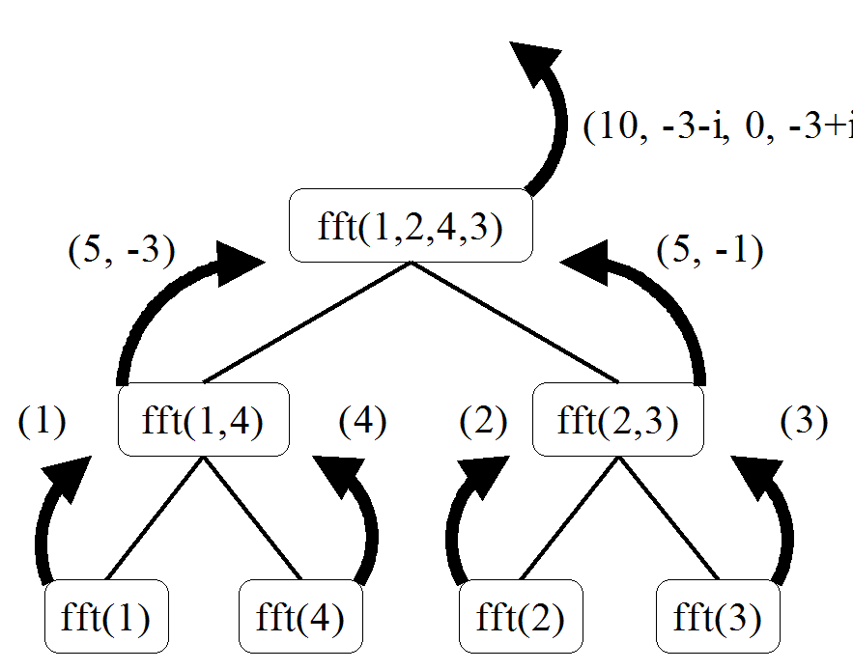

Algorithm (cont.)
Recursive implementation of FFT and IFFT(1/3)

Slide 26
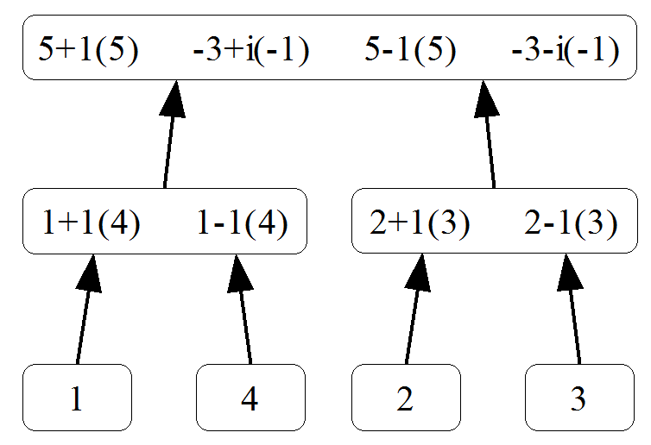

Algorithm(cont.)
Determining which computations are performed for each function invocation(2/3).

Slide 27
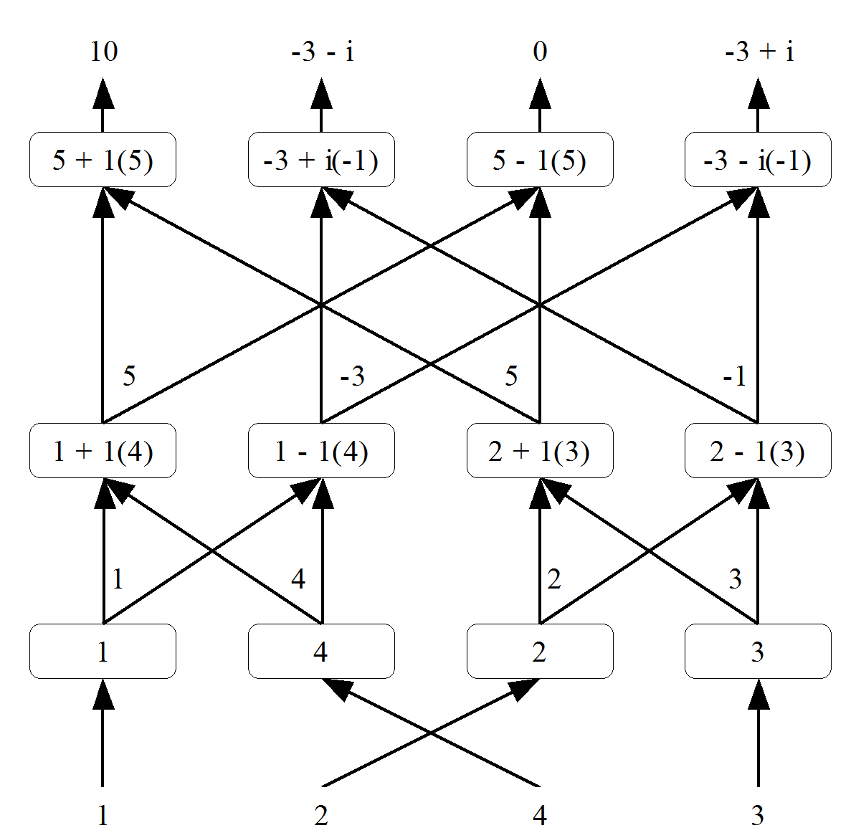
Algorithm (cont.)
Tracking the flow of data values (input vector at bottom)(3/3)

Slide 28
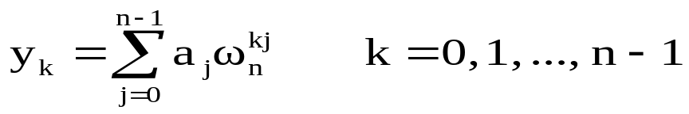
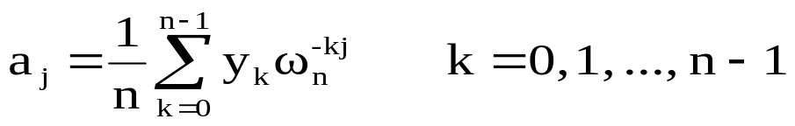
Algorithm (cont.)
Summery:
We can write FFT as ,
Where IFFT can be written as
Note:'yk' indicates point value and 'aj' indicates coefficients

Slide 29

Complexity analysis
What is the complexity of IFFT?
Ans: Since IFFT is an divide and conquer process ,so its running time is
T(n)=2T(n/2)+O(n)
which has the solution of O(n log n)

Slide 30
Complexity analysis(cont.)
How to prove this complexity?
-Using Master method we can prove this by the following process:
Since master theorem is
T(n)=a T(n/b)+f(n)
where a>=1,b>1, and f(n) be a function.
Also the T(n) has the following asymptotic bounds:
For case 1:
for some constant e>0

Slide 31
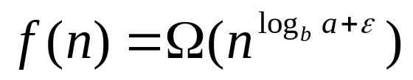
Complexity analysis(cont.)
For Case 2:
For Case 3:
because

Slide 32
Complexity analysis(cont.)
We have T(n)=2T(n/2)+O(n)
=2T(n/2)+n
Comparing it to master method
a=2,b=2 ,and f(n)=n.
Then
n^logb(a)=n^log2(2) =n^1=n
Which implies case: 2 and f(n)=O(n)
Thus the solution to the recurrence is T(n)=O(n log n)

Slide 33


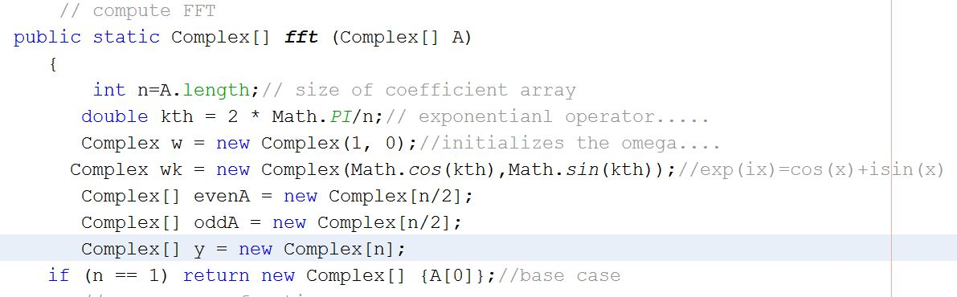
Implementation

Slide 34


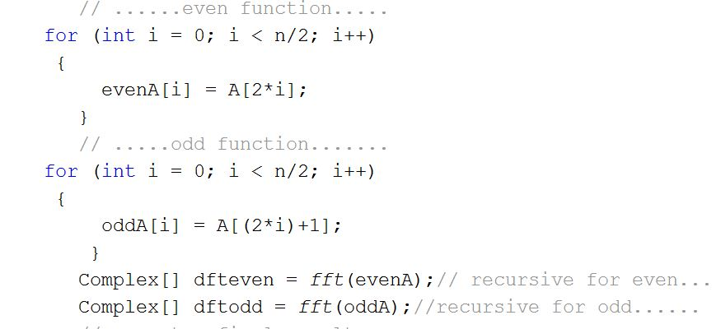
Implementation(cont.)

Slide 35

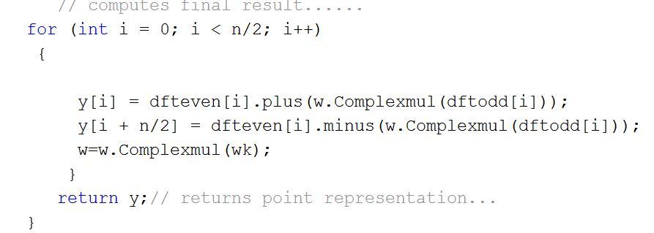
Implementation(cont.)

Slide 36

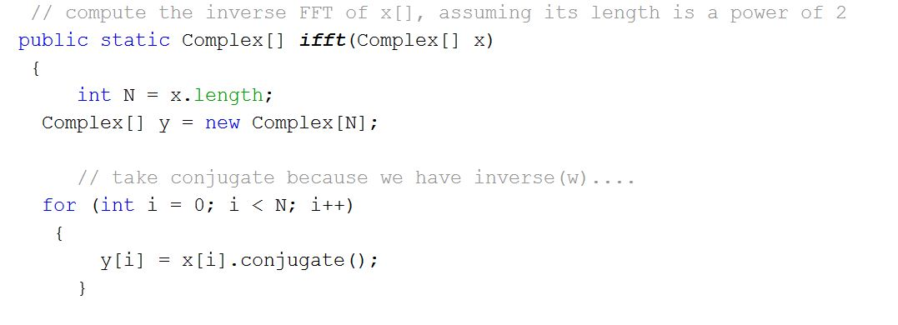
Implementation(cont.)

Slide 37
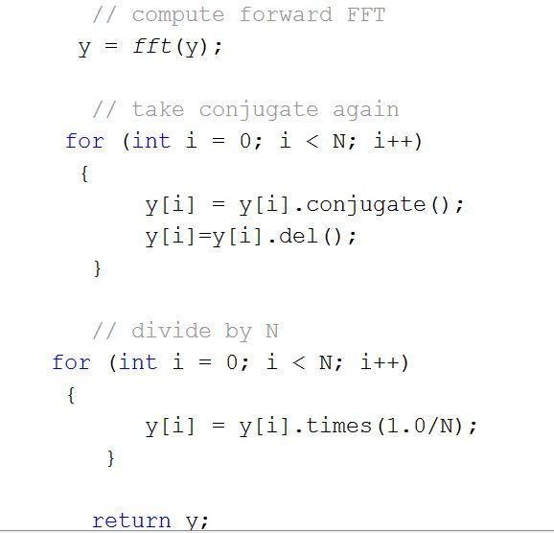
Implementation(cont.)

Slide 38
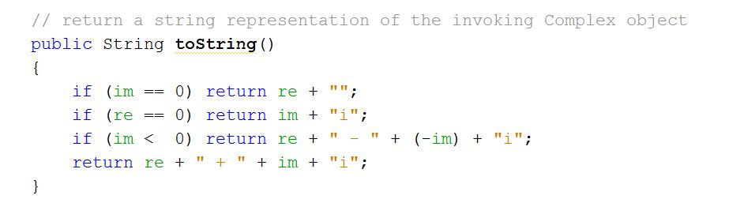
Implementation(cont.)
Complex functions:

Slide 39
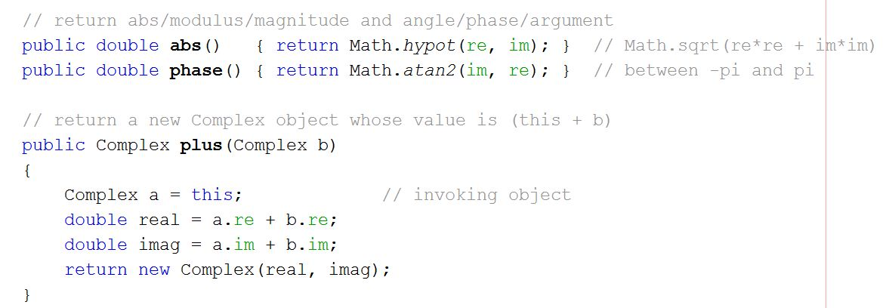
Implementation(cont.)

Slide 40
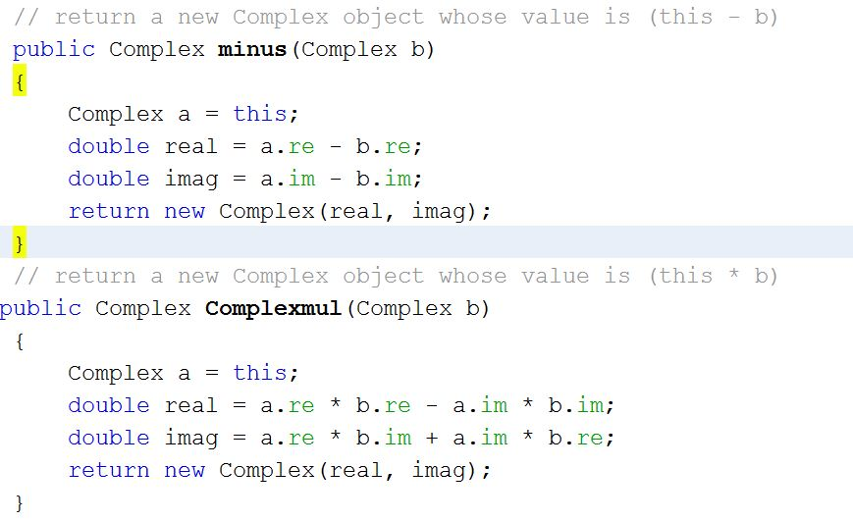
Implementation(cont.)

Slide 41
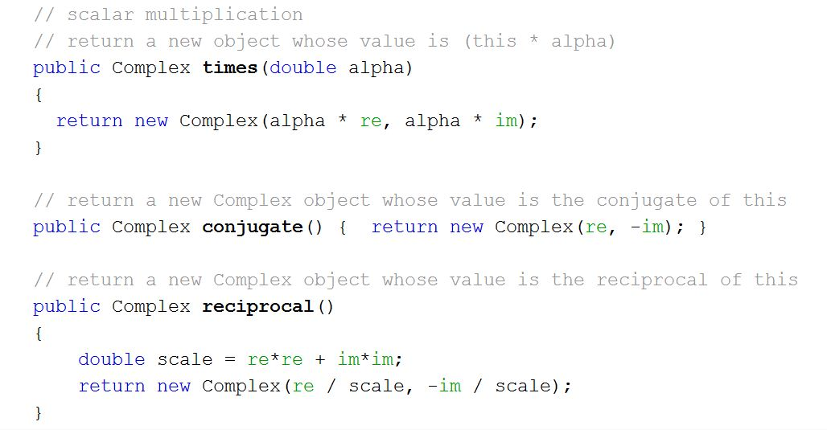
Implementation(cont.)

Slide 42
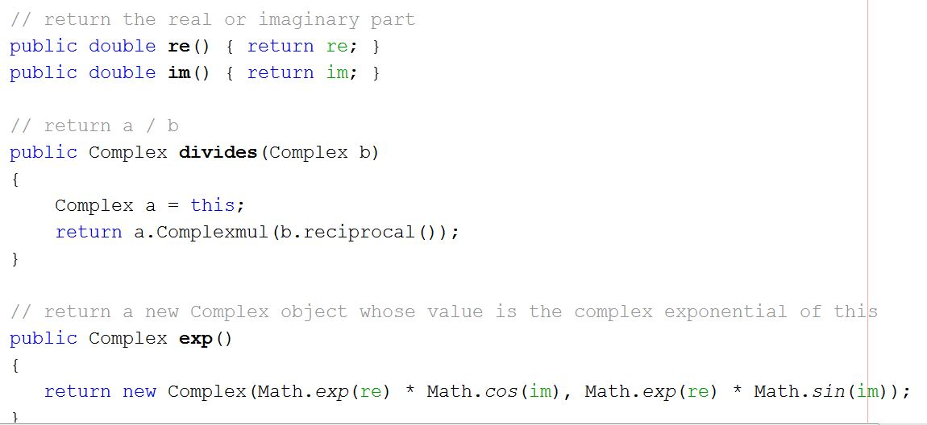
Implementation(cont.)

Slide 43
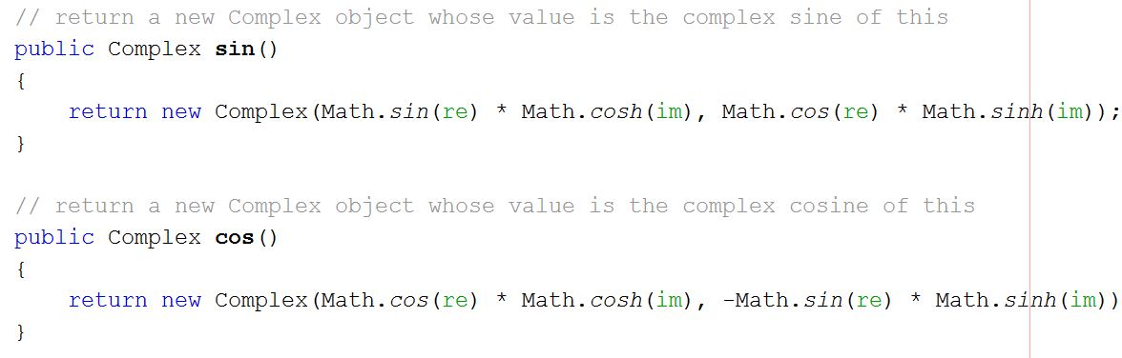
Implementation(cont.)

Slide 44
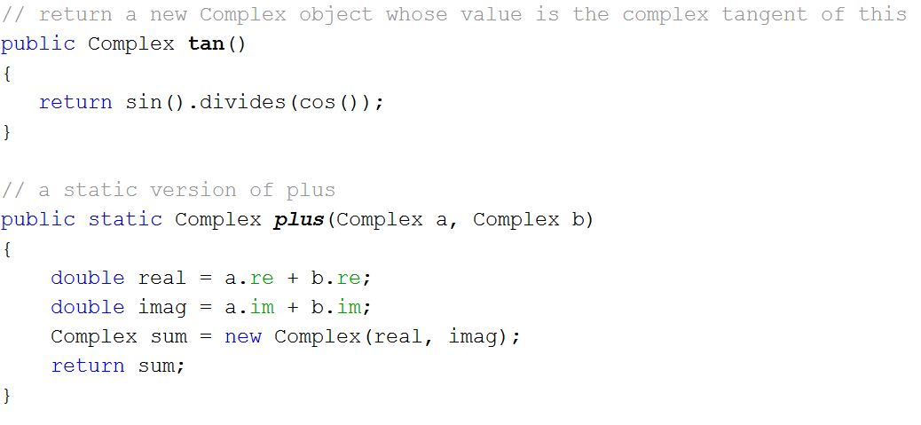
Implementation(cont.)

Slide 45

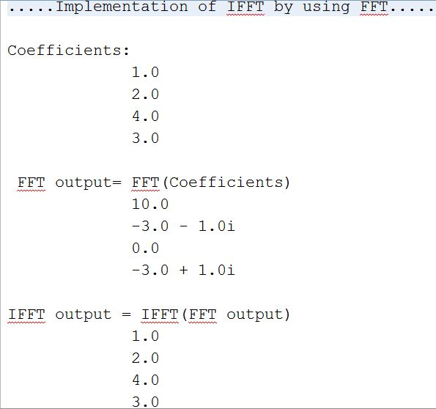
Implementation(cont.)

Slide 46
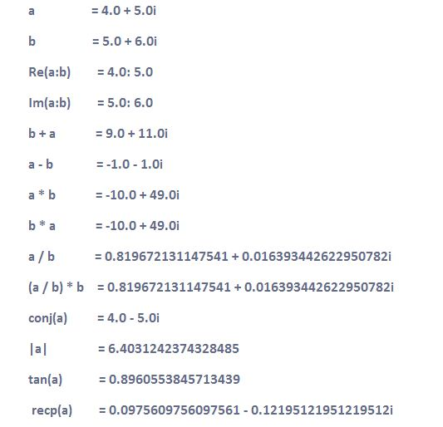

Implementation(cont.)
Complex I/O:

Slide 47
References
https://en.wikipedia.org/wiki/Joseph_Fourier

